Slide 1
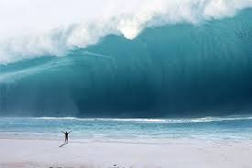
Surfing

Slide 2
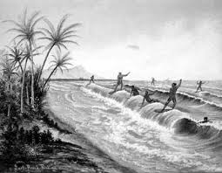
History
In Maui the waves get up to 70 feet
Surfing has been popular since the 1940’s
The first surfboards were made with wood
The longest single wave ride was 37 min
Hawaii, California, Australia, were the first places to surf
The longest wave recorded was 1,738 feet
The longest surf ride (switching wave to wave) was 3 hours 55 minutes
The first surfing competition was held in Corona Del Mar
Surfing began before Columbus was born
The Waikk club held the first inter national surf club
The first competition was held in 1968
Surfing was created for entertainment
In 1921 surfboards were created
Ancient (Before our time) Hawaiian’s surfed on wood boards

Slide 3
Rules
Don’t snake people- do not catch a wave once another surfer has claimed it
Right of way – the people that have the right of way you can’t cut off
Do not drop in during competition

Slide 4
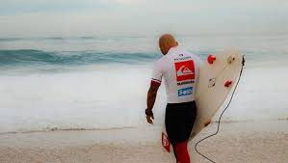
Scoring
Judging goes from 0.0 – 10.0
If no one catches a wave within the first 10 minutes of the heat the judge has the power to restart the heat
When a surfer flips off the back of the wave it is a ariel
Second place gets 1000 points and so on…
The surfers get points based on performance
Hanging 10 is when you stand on the front of the board and continue riding the wave
ariel and 360 spins are a few tricks for scoring

Slide 5
Famous athlete
Kelly Slater’s career lasted 25 years
Kelly Slater has 5 consecutive records
Carissa Moore is the top women surfer
Kelly Slater has won the most awards
Kelly Slater competed in the European championship
Kelly Slater started surfing when he was 12

Slide 6
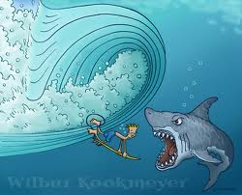
Penalties
One penalty is a interference
When a interference happens you only get the best wave in the heat

Slide 7
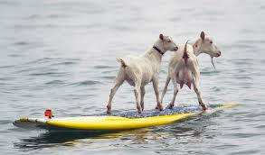
Fun Facts
Equipment – board and wet suit
Short boarding takes a lot of effort because you have to paddle harder
Some cultures have a dress code for surfing
A person that hangs around the beach and acts like a surfer is called a nodad
Wet suits are meant to keep you warm
surfboards were made light and easy to carry
Jet skis have helped surfing significantly by helping surfers get to wave break
It is consider a short board if it is under 7 feet

Slide 8
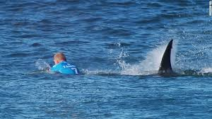
Fun facts continued
Short boarding and long boarding are types of surfing
( field ) ocean
A tube/barrel is a tunnel that travel's behind you
1,2,and 3 finned boards are called skegs
A wipe out is when you fall off your board
Duck diving is when you dive under the wave on your board
Surfing can be dangerous from drowning and being hurt

Slide 9
Credits
www.kidzworld.com
www.worldsurfleuge.com
www.sd71.bc.ca.com
www.Kidcyber.com
www.surf.htm
www.Kidrex.com
www.kaplaninitenternational.com
www.britanica.com
www.stapmag.com
www.worldbookonline.com

