Slide 1
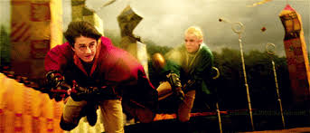
Quidditch
Today you will learn about Quidditch

Slide 2
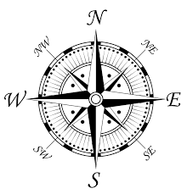
Navigation page
Field/Equipment
Rules
History
Penalties
Scoring

Slide 3
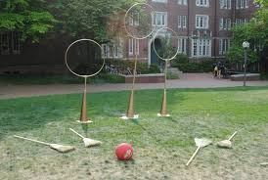
Field/Equipment
The field is 500 feet long and 180 feet wide A Fig Is a broomstick There is a Modern quaffle Seven people are on a team The chaser scores with the quaffels There is no height to rise There is 4 main balls The quaffle is 10 points The color of the quaffle is scarlet There is no time limit

Slide 4
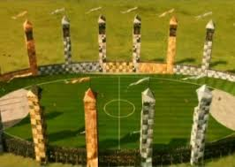
Field/equipment Pg. 2
The snidget is 150 points Only Keepers And Chaser can touch the quaffle 10 position on the field The snitch is based on the golden snidget The keepers scores with the quaffle The council didn’t suggest building a brick wall 13 different teams The Golden snidget is walnut sized 3 Chaser,2 Beater,1 keeper, And 1 seeker The newest fig has an invisible cushion The quaffle is made of leather The modern quaffle is 12 inches

Slide 5
Rules
Must stay in Boundaries
The only time a player is allowed on the ground is during timeout
You catch the golden snitch to end

Slide 6
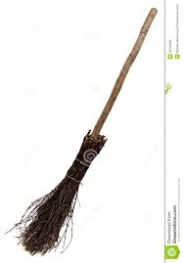
History
1269 is when quidditch began.
The golden snitch wasn’t caught for six months.
The longest game lasted three months.
Queerditch marsh is where it originated.
In 2005 a player rode a lamp instead of a broom.
In 2006 quidditch became more popular.
There was a world cup in Kissimmee.
There is an ancient Quaffle.

Slide 7
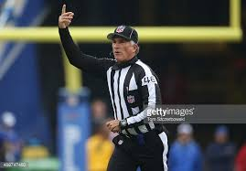
Penalties
If you tackle someone that is a penalty.
There are 700 fouls.
There are 4 maximum gender rules.
The ref is called a quijudge.

Slide 8
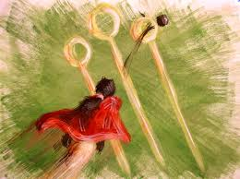
Scoring
There are 13 different plays.
There are 2 scoring areas.
There are 6 goal baskets.

Slide 9
Credits
HarryPotter.wikia.com
FactMonster.com
FunTriva.com
UsQuidditch.org/
Mugglenet.com
Quidditch through the ages (Book)

Slide 10
Thanks for watching
Thanks for watching my slide show

