Slide 1
CURLING
Let me introduce you to the world of curling . I’m going to start with history.

Slide 2
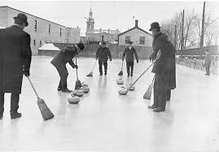
HISTORY
The scots were the first people to play curling in 1541.
The oldest curling stone was made in 1511.
Curling first became an Olympic sport in 1924.
The first curling championship was held in 1985
America found out about curling by British troops.

Slide 3
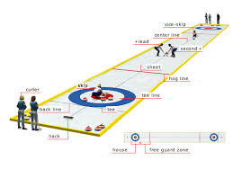
POSITIONS/JOBS
the Team members are called the lead, the skip, the first, and the second.
The first and the second are the broom holders.
The skip is the captian of the team.
The vice skip is the same as the normal skip.
The lead helps guide the skip were to throw the stone.

Slide 4
Famous Athlete
His name is Brian Anderson.
He was born May 1st 1975.
His position on the team is the lead.
He started curling in 2005
He played in the Men’s Club and was the champion in 2009 and 2010.

Slide 5
SCORING
The team with the most stones closest to the center get the points.
The bullseye is what gives the team points when their stone lands on it.
Every stone closer to the center is worth one point.

Slide 6
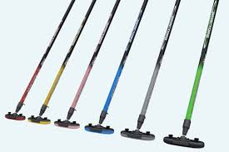
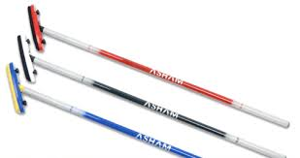
RULES/EQUIPTMENT
Each team has ten shots.
The rink is 42.07 meters long.
Each team member has two shots.
The players have special shoes to grip the ice.
There is two different kinds of brooms a push broom and a Canadian broom.
The stone is made of dense granite.

Slide 7
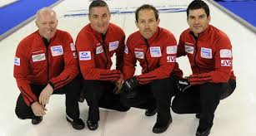
PENALTIES
APPAREL
The team wears polo t-shirts.
The pants are long and black.
A delivery violation is one of the PENALTIES
Tuching the handle of the stone after it’s over the hogline results in the stone being removed from play.

Slide 8
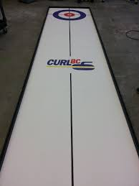
FUN FACTS !!!!!!!!!
America has four gold medals.
About one million two hundred people are registerd curling players.
In Canada curling is as famous as ice hockey.
The ice is sprinkled with water drops at the start of the game.
It is also known as the roaring game.
The most points scored in one end was 8.
An end is like a quarter in football except there is 10 ends.
This is basically shuffleboard on ice.

Slide 9
Credits
I would like to thank all the websites that gave me information.
www.Shortrockcurling.com
www.Olympic.org/sports/curling
www.factmonster.com/sport/winter
www.teamusa.org
www.topendsports.com
www.stichylizard.com
www.funtrivia.com
www.worldbookhotline.com
Kidcyber.com/tag/curling-facts-for-kids
www.10-facts-about-curling.com
The-rules-of-curling.com
Wikipedia.org/wiki/list-of-mens-world-curling-champions
Activeforlife.com/olympic-curling-with-your-kids
www.curlingschool.com

