Slide 1
The AMAZING WORLD OF GOLF
By Nicholas Ian Coles
Notes:
A special thanks to Golf info.Guide.com, Golf guide to everything golf., Golf news, and last but not least gsp rocks

Slide 2
The History of golf
This amazing sport was first played in 1,000 A.D.
In 1457 in Scotland golf was banned due to it being a danger to archery practice.
James VI of Scotland brought the game to England.

Slide 3
Rules of golf
The ball must be played where it lays.
A player mustn’t take action to influence the movement or play of the ball.
If the opponent’s ball is at rest the player may concede.
Notes:
These are just three rules in the rulebook of golf!

Slide 4
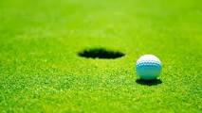
Scoring in golf
There is only one way to score in golf, and that is hitting the ball into the hole.
To win you need the lowest amount of hits into the holes by the end of the course.

Slide 5
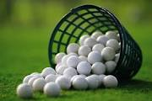
Equipment in golf
The average golfer has fourteen clubs in their bag.
There are three main clubs in golf are woods, irons, and putters.
Notes:
{ Clubs are the things you hit with in golf }

Slide 6
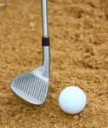
How to get penalties
If your ball lands in the water you get a penalty stroke.
If your putt hits the flag in the hole you get a penalty stroke.
Notes:
A penalty stroke is a additional hit on to the original stroke

Slide 7
Famous athletes
Jason Day has the worst ranking in the PGA Tour.
Jordan Spieth is moving back towards no.1.
Arnold Palmer got into the golfer’s hall of fame in 1994.
Phil Mickelson was picked for the President’s cup.
The average scoring for Arnold Palmer is 77.049.
“ I never quit trying even though I have no chance to win.” – Arnold Palmer

Slide 8
Fun facts
Tiger Woods almost won all four major tournaments in the same year!
Arnold Palmer won championships in: 1958 and 1960.
During segregation there where leagues for African Americans.
The equipment has evolved over the years.
Early golf balls were feathers stuffed in leather balls.
Mary Queen of Scots was the first woman golfer.
Golf is one of the most popular sports played outdoors.
The rules of golf haven’t varied much over the years.
Six par holes are rare but exist.
The oldest known golf course is four hundred years old.
Birde is slang for one over par.

Slide 9
Thank you
I would like to thank you ladies and gentlemen for listening to my power point. :p

