Slide 1
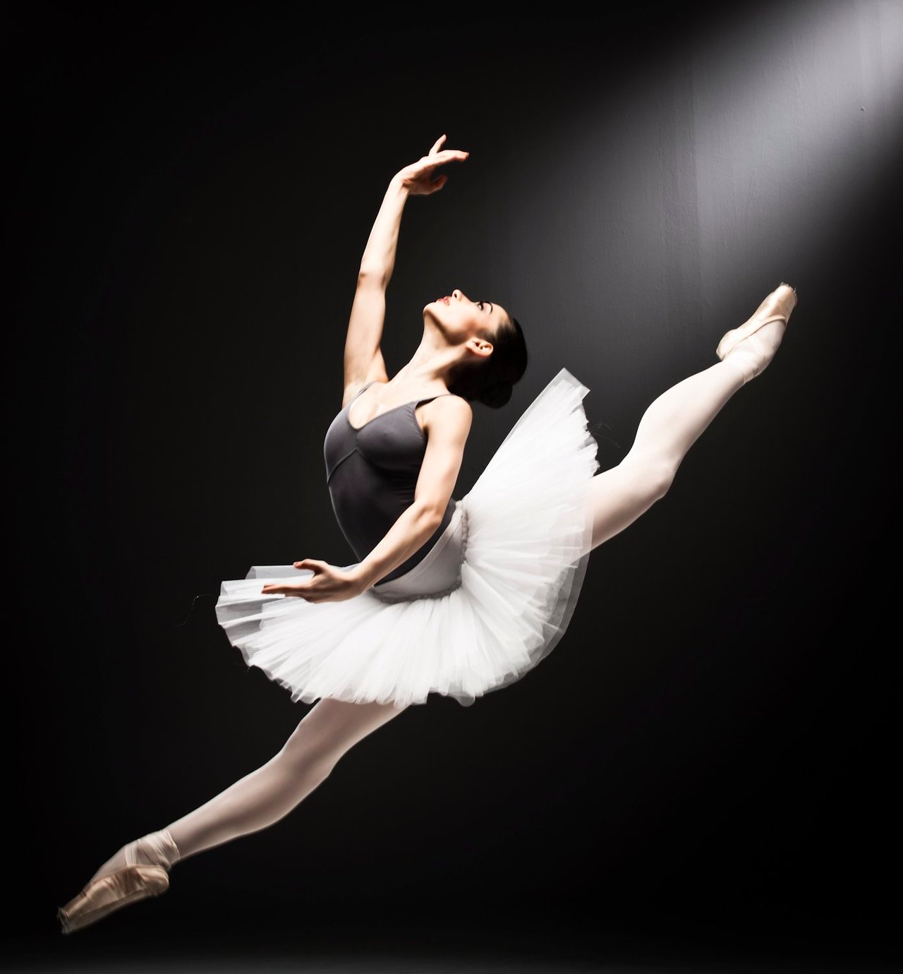
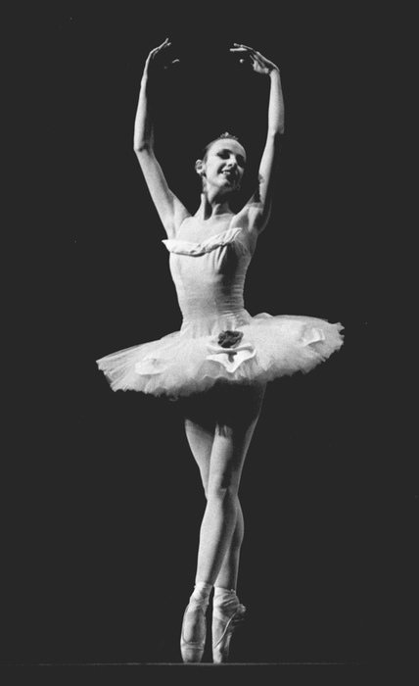
Dance
BY: Natalie rolfe

Slide 2
penalties
First I am going to talk about penalties
If someone hurts their partner or anybody the penalty is the judges will damage your score.
Most commonly the dancer probably will be fined.
If the dancer accidently hurts their partner they will still get a penalty.
Also a dancer could be penalized for inappropriate content in the music or talking.
Another penalty is the dancers score could drastically lower.

Slide 3
Music
There is no maximum or minimum of songs in a dance teams remix for music.
The CD for music must have no scratches.
There is absolutely no offensive language in the music.
So the DJ does not get mixed up, write the team name on the music CD.
The dance team’s music must be downloaded onto a USB drive or a CD so the DJ
can play the music for the dancers to dance to.
To make the dance more interesting the dancers can add sound effects.

Slide 4
Rules for dance
In the second round of the dance competition the dance teams can change their dance if they do not like the dance.
Looking for a break ?Well when your dance is over you get your break.
The dance judges do not provide music for the dance team’s dance.
THE AWARDS:
1. High Gold 2. Gold 3. High Silver 4. Silver 5. Platinum Plus 6. Platinum
Once the judges make the decisions on your score that is final.
This is a funny one but keep your beards to your self. There are 4-10 judges in a dance competition.
The professional dancers usually preform on a stage. Props: tables, chairs or each other. Apparel : skirts, shirts, dresses, t-shirts or long sleeve shirts.
The judges expect the dancers to have 3-9 dances.
In free style dance there is no acrobatics.

Slide 5
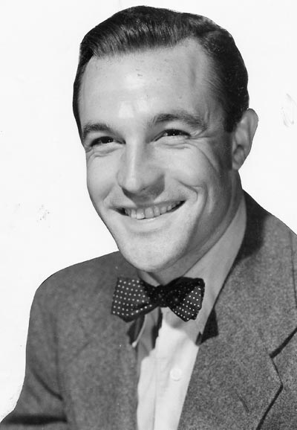
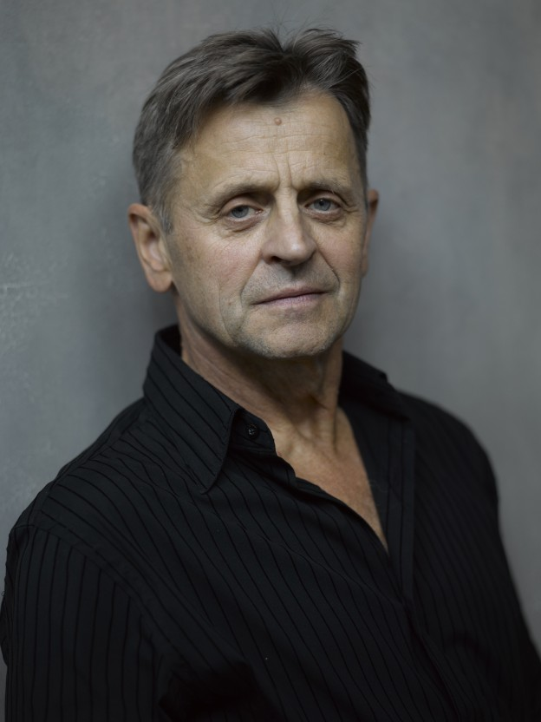
GENE KELLY AND MIKHAIL BARYSHNIKOV
Gene Kelly
Gene Kelly was ranked the 6th most celebrated dancer in America. He was born in 1912. Gene Kelly preformed in the famous Singing in the Rain. He started his career in the 1930s and ended in the 1980s. Gene Kelly’s record is 9 plays which is a lot for dancing.
Mikhail Baryshnikov
Mikhail Baryshnikov says he is better at dancing than choreography. Mikhail is a contemporary and ballet dancer. Mikhail is from Russia. TV helped him with his career a lot. Mikhail is the most celebrated dancer.

Slide 6
time
A mega line has six minutes to preform their dance. A beginner team can’t have more than 1 minute and thirty seconds to preform their dance. A trio has 4 minutes and 45 seconds to preform. A adult or 2 adults get 2:00 minutes to preform. All people get 5 seconds to adjust themselves. Kids age 1-5 get 1 minute and thirty seconds to perform their dance. A small group gets 3 minutes preform. A large group gets 4 minutes.

Slide 7
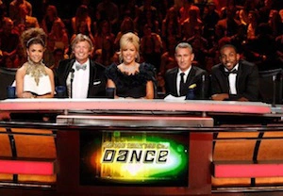
scoring
Whomever has the most points wins the dance competition. Signature moves help lift scores. The first place winner is scored a one hundred.The dancer that gets second place is scored a 75. The judges usually score from 0 to 100, but sometimes they score from 75 to 95. The best placing you can get is first place the worst dancers can get placed is 6th place depending on the competition.

Slide 8
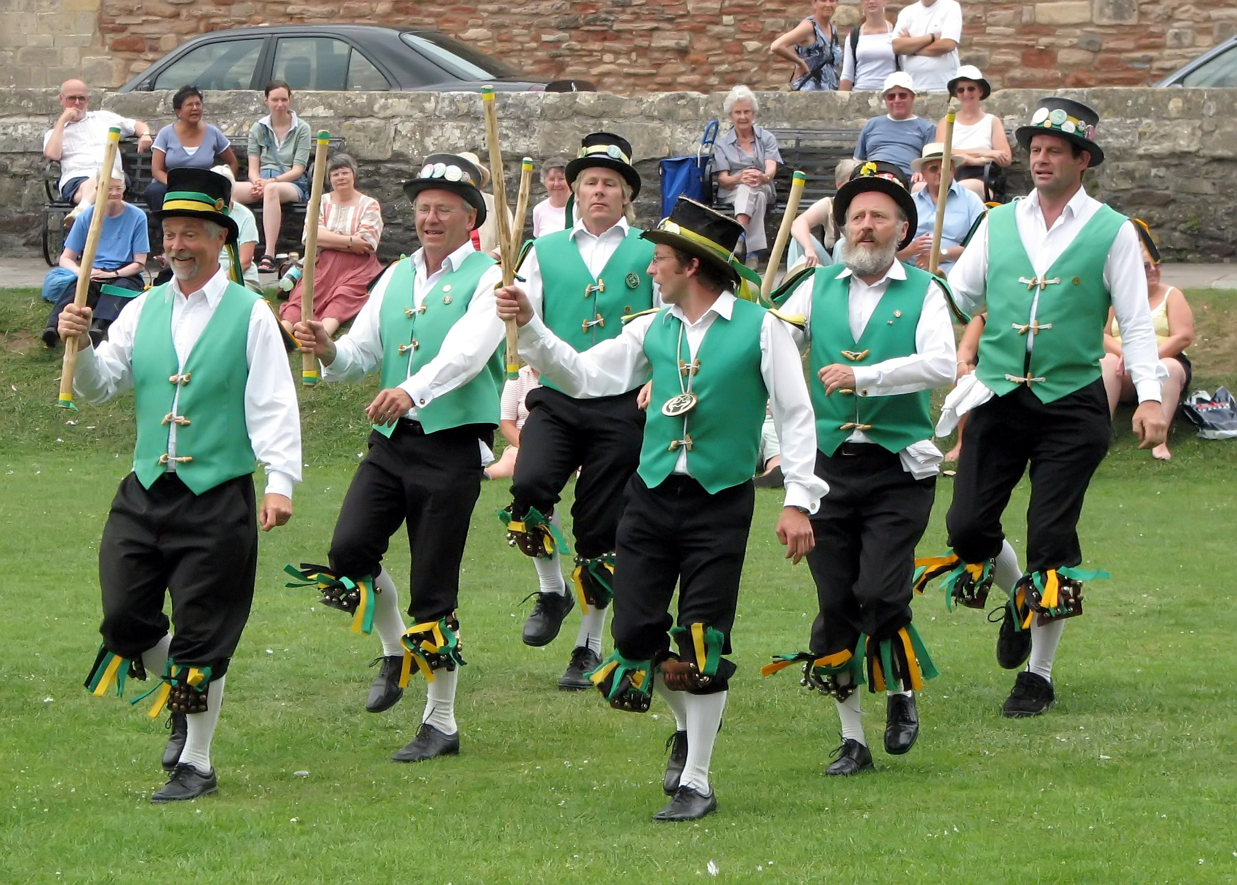
History
Animals started dancing since the beginning of time. Contemporary started in the1950s. Rock dance started in 1960. Rock dance was used in many different ways in the late 1980s. People dance everywhere, at festivals and at home. Some people dance in a religious ritual group. There are festivals for dance all around the world.

