Slide 1
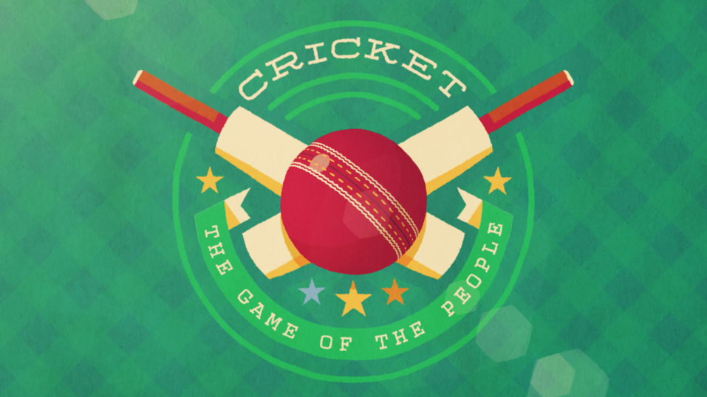
By: Muizz Anchur

Slide 2
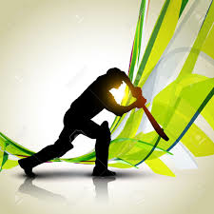
HISTORY
Cricket started in England in the 16 century
Cricket originated in the dark ages
Cricket like games called Club ball and Stool ball was played in England 500 years ago
The first women’s game was held in Surrey, England in 1745

Slide 3
NEEDS
Cricket is played on a round or oval field of grass
Cricket is played against two teams with eleven players in each team
You must wear peaked caps, open necked shirts, trousers, spiked shoes, and gloves
A wicket is a stump that is 71.1 centimeters high
A pitch is a rectangular strip between the wickets

Slide 4
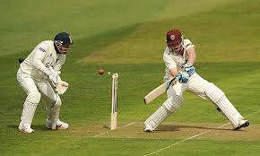
RULES
A cricket game maybe paused/suspended because of bad light and rain
Cricket can also be paused or suspended for hedge hogs, bees, sparrows, and mice
The National Cricket Council (NCC) makes and publishes rules of cricket
Hitting a players leg pads makes them out
A major cricket match may last 1 to 5 days or more

Slide 5
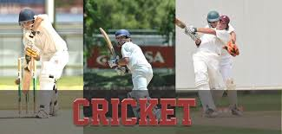
Positions
The fielding side consists of the bowler, wicket keeper, and fielder
Each team must have nine fielders on the field
The batsmen are called strikers
The striker is the only one that can score a run

Slide 6
Penalties
Sometimes you have to pay
Other times you get suspended
Sometimes you get fined of captain

Slide 7
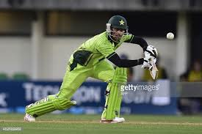
Scoring
A double century is 200 runs
When the batter hits the ball over the boundary it is 6 points
When the batter hits the ball to the boundary it is a four
To score a run each batter runs to the other wicket

Slide 8
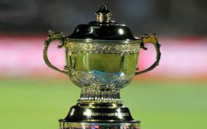
Interesting facts
The best known cricket ground is the Lords cricket ground
Cricket is most popular in England
The largest crowd to watch a cricket match was a total of 250,534 people
Some major cricket matches are tests and odi

Slide 9
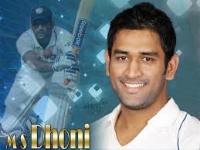
Famous athletes
Sachin Tendulkar helped Shahid Afridi hit the fastest odi century
Wilfred Rhodes of England played test cricket till he was 52 years old
Alec Stewart got 8463 test runs and he was born 8/4/63
Allen Border played 153 consecutive test matches in his life

Slide 10
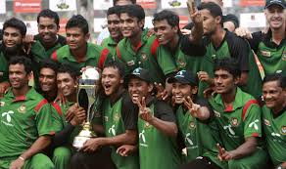
My country’s team

Slide 11
Hoped you had fun

