Slide 1
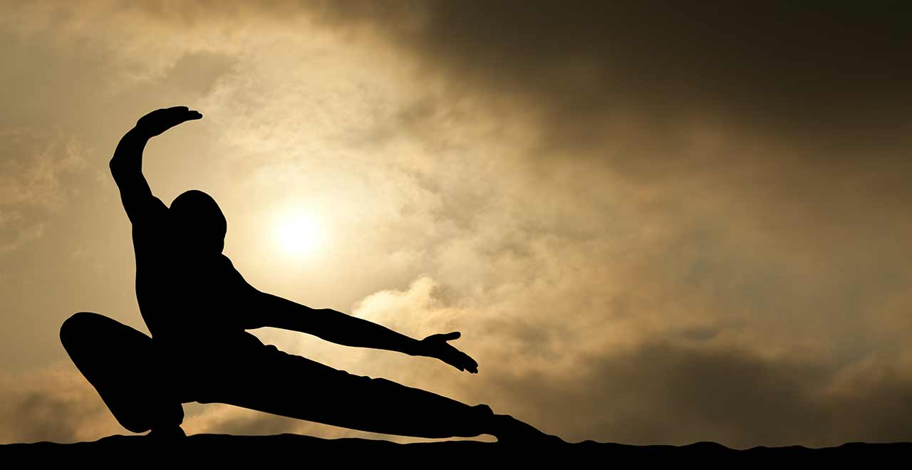
Martial Arts
By Morgan

Slide 2
History and famous athletes
It was created in 400 B.C.
Ancient Olympics got Martial arts in 648 B.C.
Judo was created in 1882.
Martial arts does not have many records
Bruce Lee played against Jhoon Ree in 1968
He played from April 27-1940 to July 20-1973

Slide 3
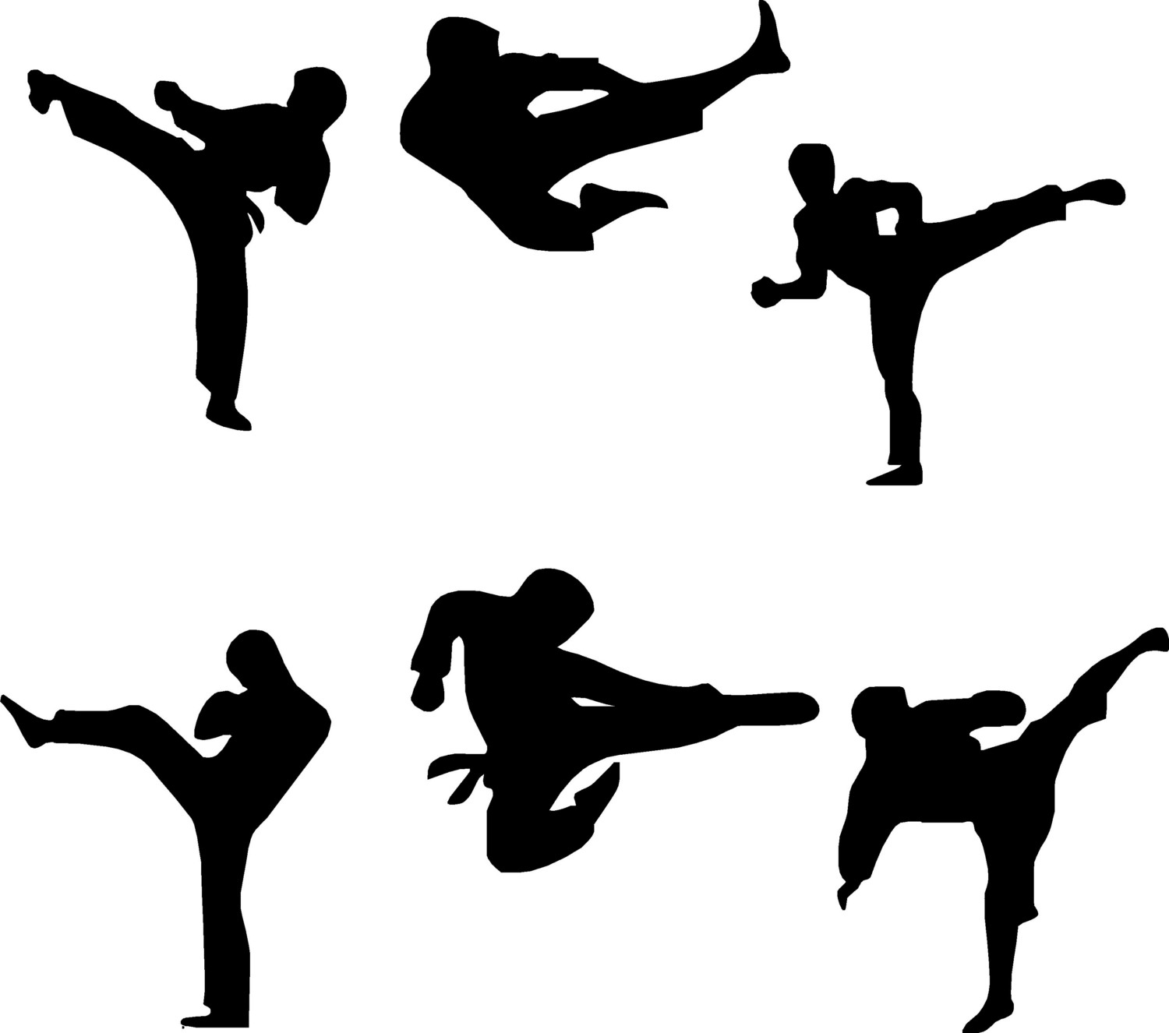
Forms and where they come from
First of all, I will say all the forms and where they come from. Martial arts comes from Japan, China, Korea, Brazil, Israel, Greece, UK, and Thailand. Karate comes from Japan so does Jujitsu, Judo, and Kendo. Are there weapons involved? Yes there are. The other forms I have not listed above are Akido, Kung Fu, Taekwondo, Capoeira, and Tai chi.

Slide 4
Rules
Mouth guards and fist pads are mandatory.
Bow before fight.
During match only 1 coach can help.
After you get 4 yellow cards the order to do is 1.instruct 2. disqualified 3. order to leave.

Slide 5
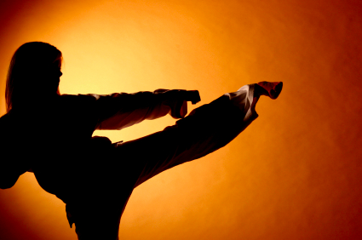
Equipment
Belts and sashes.
Reactor bag.
Grapple buddy.
Sport bags.
Bobby Bully.
Mats.
Wave master
Apparel

Slide 6
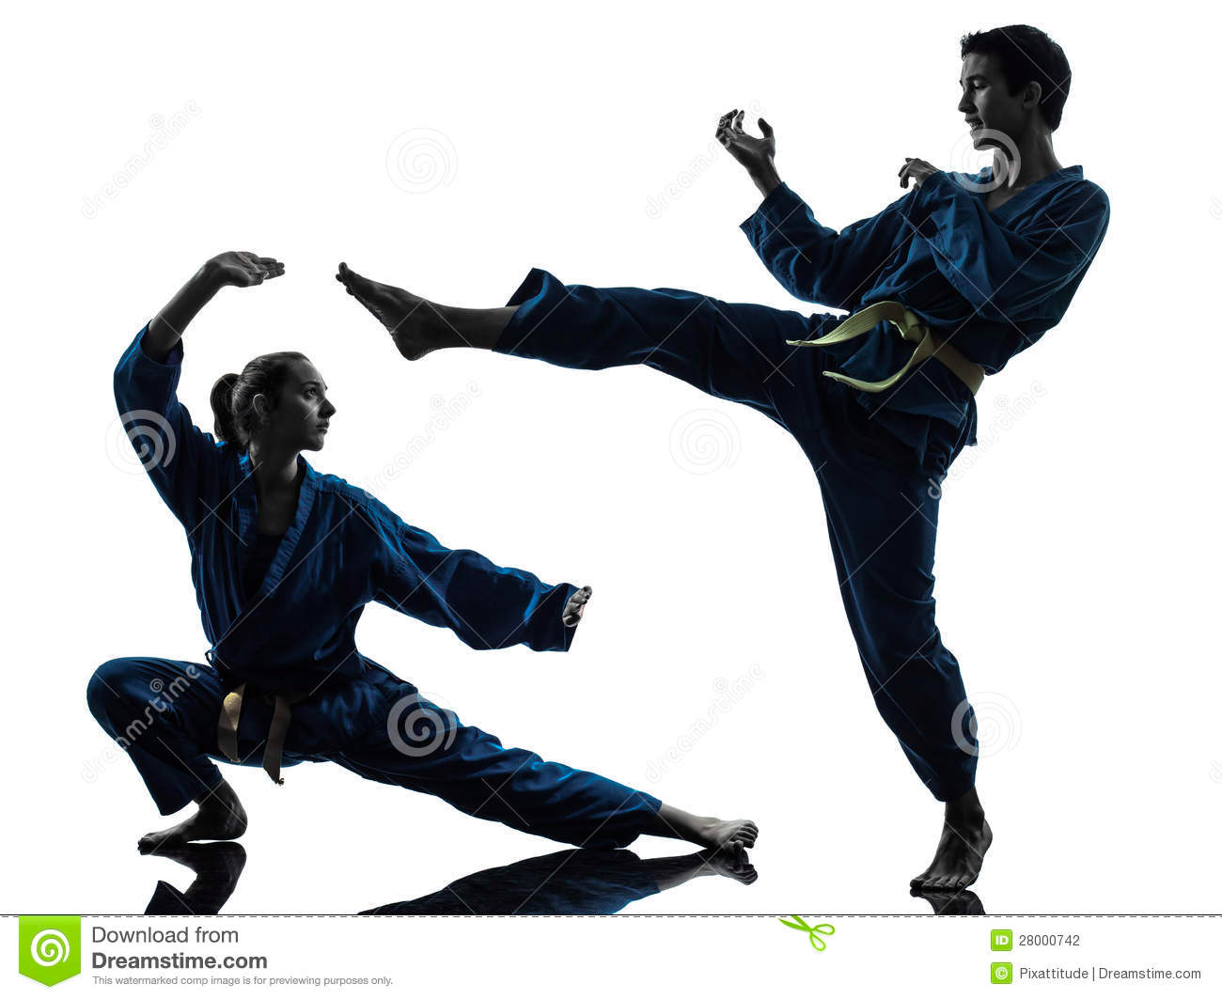
Penalties
4 yellow cards = a penalty.
Chasing or pushing of the mat is a penalty.
Hitting people in private areas or face is a penalty.

Slide 7
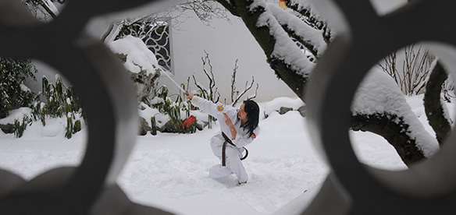
Scoring
A Yuko move will give you 1 point.
An Ippon move will give you 3 points.

Slide 8
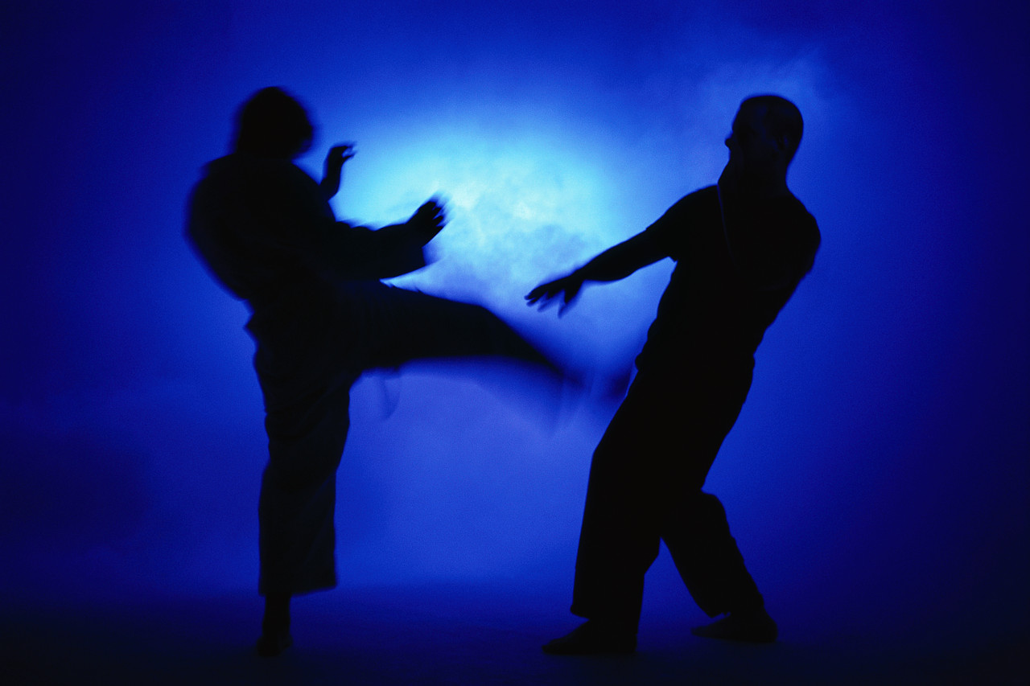
Interesting Facts
Asia is the center of the martial arts world.
There are different places for different forms.
You can spar in practice.
Belts and sashes usually go in order yellow, green, blue, purple, brown, and black.
Tai Chi has been claimed to reduce stress and lower blood pressure.
Randy Richard broke concrete blocks with his bare hand.
A famous Martial arts academy is called Wesley Chapel Martial arts academy.

Slide 9
Interesting Facts x2
Bruce Lee has the fastest kicks seen by the world.
Olympic sports include Judo and Taekwondo.
Martial arts is a form of self defense.
There are Martial arts pick up busses for some summer camps.

