Slide 1
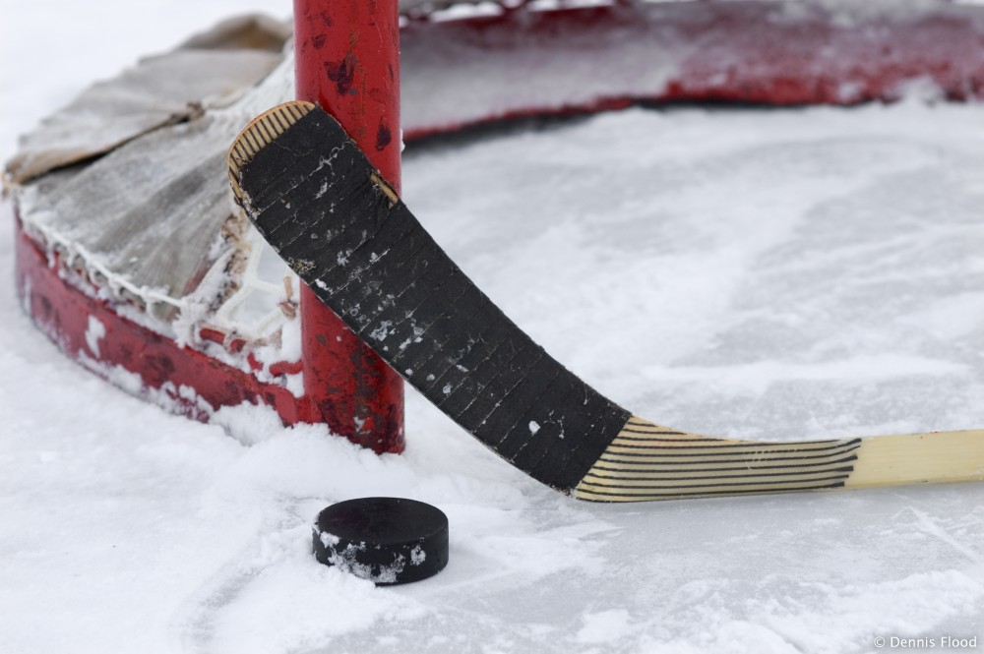
Hockey
By: Mikkel Lambert

Slide 2
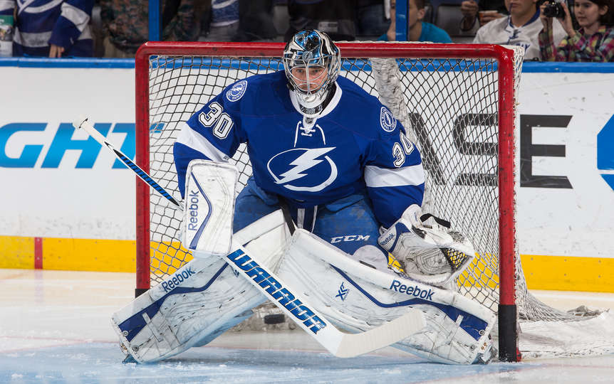
Ben Bishop
Ben Bishop has been playing hockey since 2004.
He played a game of hockey through a torn muscle.
Ben Bishop was in a major game called The Stanly Cup.
His position is goaltender.
Ben Bishop has over 3,000 saves in all that’s just one of the amazing facts about him.

Slide 3
Rules
The equipment you need to play hockey is a helmet, shoulder pads, gloves, hockey sticks, mouth piece, puck, and skates.
Some other rules are in hockey you have to play on ice.
You also have to have a goalpost and net.
There has to be benches for players when they are not on the ice.
Two teams are necessary to play a game.
The goalie cannot touch or carry the puck on the other side of the blue line.
A goalie wears extra thick padding under the uniform.
Each team has six players on the ice at once.
The thickness of a hockey puck is three inches.
The standard hockey rink is two hundred feet.

Slide 4
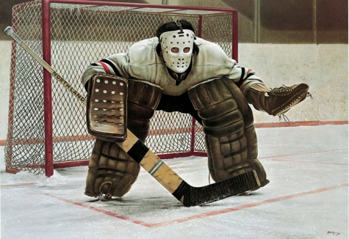
History
Hockey began in Canada in the mid 1800’s.
The first indoor hockey game was played March 3, 1875.
The NHL was founded November 22, 1917.
The first NHL goal was scored on December 19,1917 by Dave Richie.
In hockey 1927\28 backwards passes were not allowed.
The Detroit Red Wings beat the Montreal Canadians in the sixth overtime period that is equal to 3 games in one night.
Former Philadelphia goalie was the the first goalie to ever score a goal by shooting the puck into the net.

Slide 5
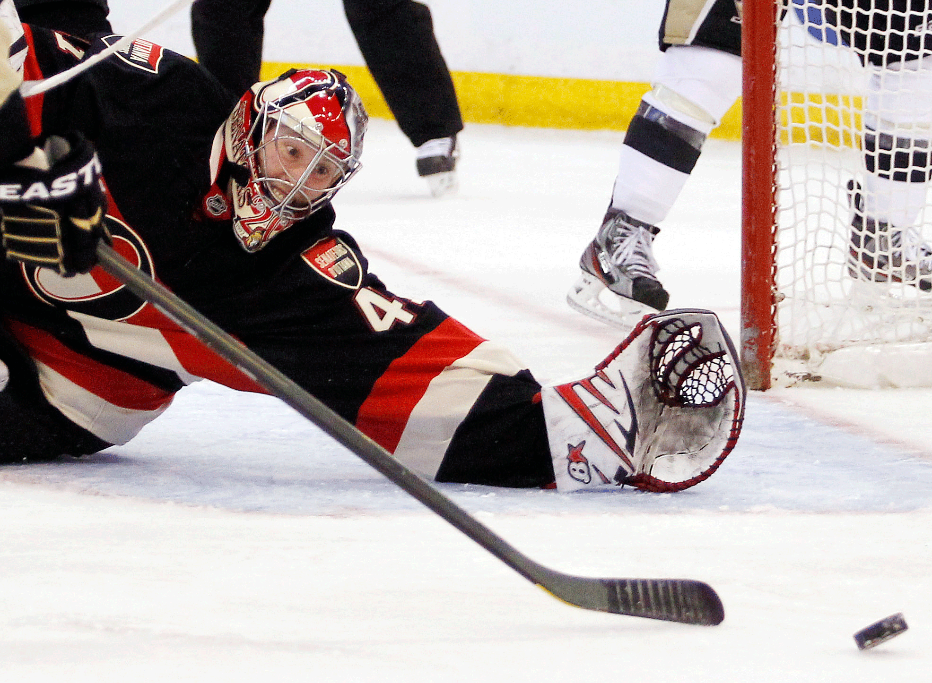
Scoring
You score by puting the puck into the net.

Slide 6
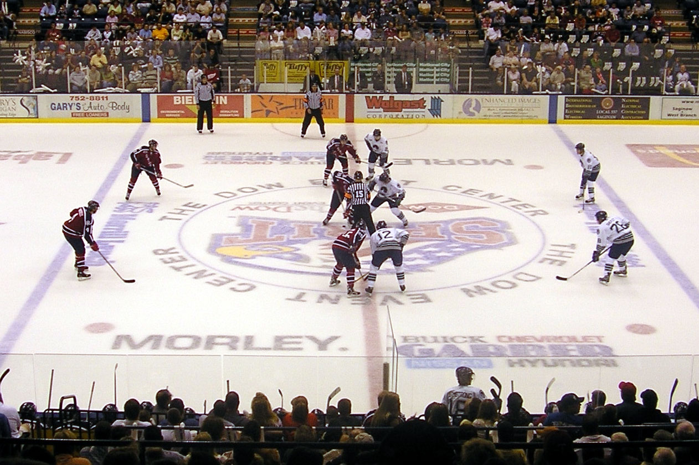
Positions
The positions in hockey are goaltender, right defensive men, left defensive men, right wing, left wing, and center.

Slide 7
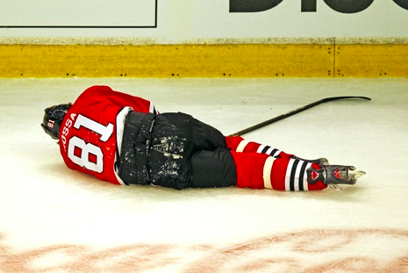
Penalties
Checking from behind: hitting an opponent without them knowing.
Elbowing: when a player uses his elbow to foul an opponent.
Hooking: using your stick to trip your opponent.

Slide 8
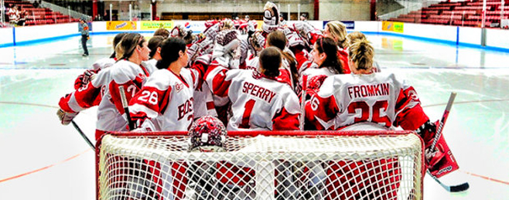
Fun Facts
Bobby Hull’s slapshot was 118 miles per hour that is the fastest ever recorded.
The Montreal Canadians have won the most Stanley cups (23).
Hockey is also called ice hockey.
Most hockey rinks have player benches and penalties boxes.
The first rubber hockey puck was made of sliced lacrosse balls.
Each period begins with a faceoff.
Goalies block pucks at lightning speeds.
A Swedish player once scored by dropping the puck out of his pants.

