Slide 1
Tennis
By Madison Hunt

Slide 2
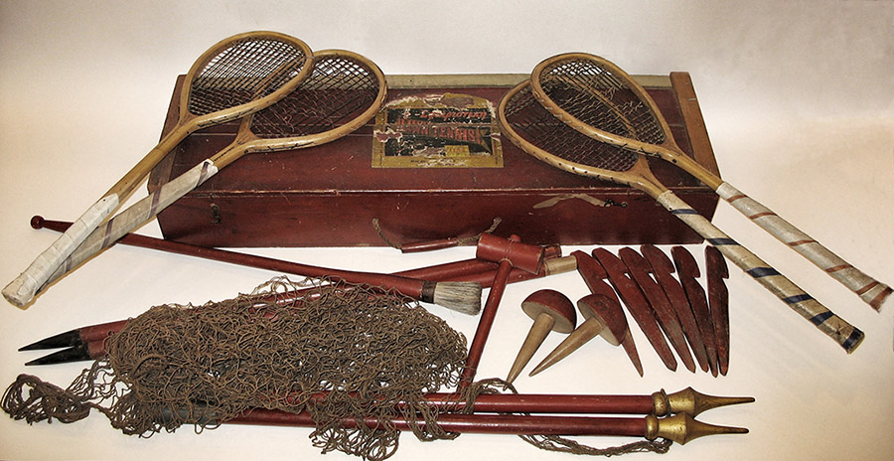
The history of tennis
~ Mary Ewing Outerbride introduced lawn tennis in 1874.
~ Tennis originated in Birmingham, England.
~ Tennis has been around for 140 years.
~ The first tennis balls were wool wrapped in leather.
~ The game was first called sphairistike. It was patented in 1874.
~ The first version of tennis was either played with webbed gloves.
~ The first tennis club was located in Leamington Spa.
~ Longest match: 11 hours and 5 minutes
~ The first female players wore full length dresses.
~ The first Wimbledon championship was in 1877.

Slide 3
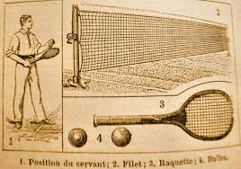
More history
~ Tennis was removed from the Olympics in 1924 but came back in 1988.
~ The creator is Walter c. Springfield.
~ In 1985, Boris Becker won the Wimbledon tournament at 17.
~ The strings on a racket used to be made from animal organs.
~ Tennis was first played at a garden party in wales.
~ Tennis has been in the paralmpic games since 1992

Slide 4
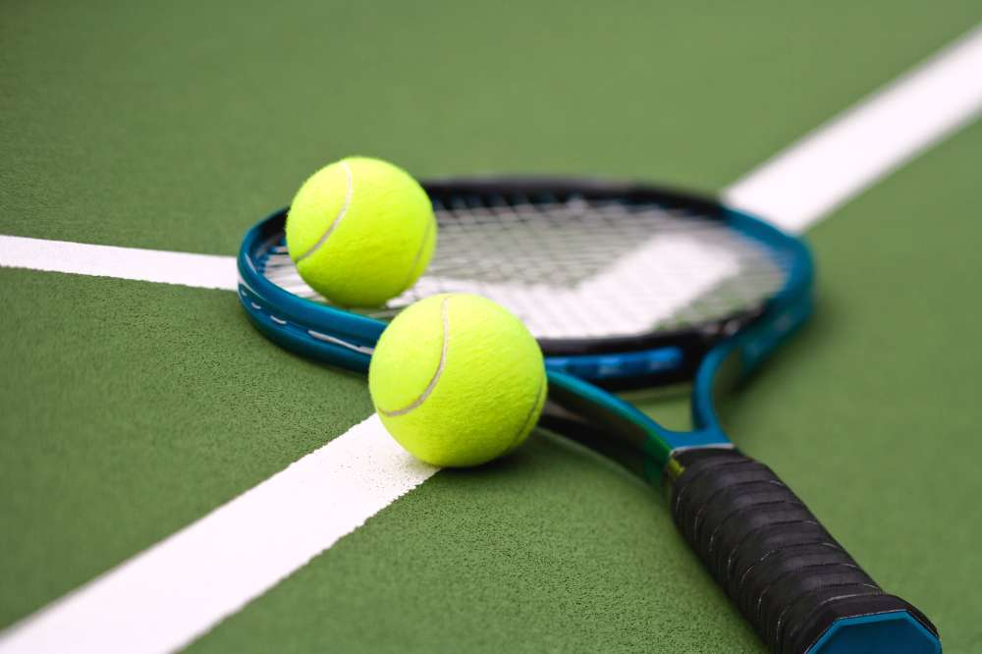
Rules
~ You must hit the ball over the net.
~ Tennis balls are bright colors so people can see them.
~ All clothing has to be the same shade - bright white.
~ To win a set in tennis, you need to win 6 games.
~ You need 4 points to win a game.
~ You need mostly two sets to win a match.
~ The standard height of the net needs to be three feet.
~ The maximum length of a racket went from 32
to 29 inches.
~ Tennis can be indoors or outdoors.
~ The standard length of a court needs to be 78 feet.

Slide 5
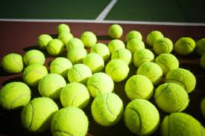
MORE RULES
~ If you hit the ball onto the other players side, it is a point.
~ Tennis can be inside or outside.
~ The three main tennis courts are hardcourts, clay courts, and grass.
~ Tennis balls are made of felt and hollow rubber.
~ A doubles match court is 36 feet wide.
~ If the ball touches the net, it is considered a good return.
~ There can be singles teams and doubles teams.
~ Hardcourt can be concrete, asphalt, wood, and astroturf.

Slide 6
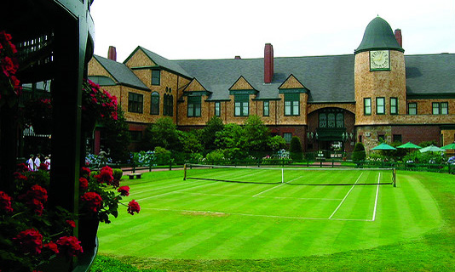
tennis hall of fame
the tennis hall of fame is in Newport, RI.
Athea gibson was the first African American to compete in the U.S. championships.
Arthur Ashe was the first African American to win the U.S. open.
Serena Williams wore white and magenta in 2012.
Pete Sampras won 40 million in playing money and is known as the most rich player.
The first person to wear shorts to a match was Henry Austin.
In 1997, Martina Hingis was the youngest tennis player to rank no. 1.
The first sisters to win olympic gold medals were Venus and Serena Williams.
Helen Wills Moody ranked number 1 nine times from 1927 to 1933.
The first Wimbledon winner was Spencer Gore.
Rod Laver won four mens Grand Slam games.

Slide 7
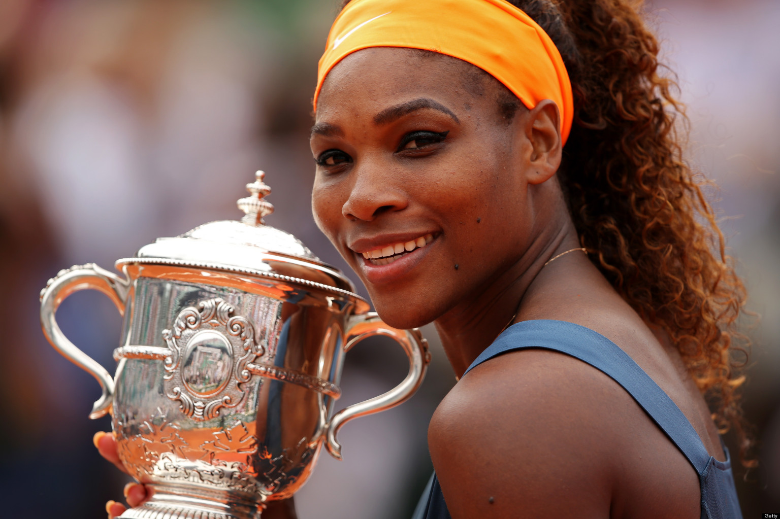
Famous athlete
~ Serena has won 35 million in prize money.
~ Serena has a line called Aneres.
~ Serena has played since 1995.
~ She has earned two Olylmpic gold medals.
~ the second person to have 6,000 points in one year is Serena Williams.
~ Williams is Jehovah’s Witness.
~ Williams was born on Sep. 26, 1981.
~ Serena has played in the Olympics, the U.S. Open, and many more.

Slide 8
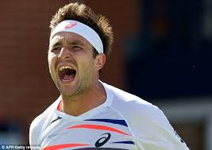
penalties
If you throw the racket or use verbal abuse, that is a penalty.
You usually lose several points for a penalty.
You also get a penalty when both players on a doubles team touch the ball at the same time.
If you hit the ball twice before it goes over the net, that is included as a penalty.

Slide 9
REASONS TO PLAY TENNIS
Tennis teaches manners and rule following.
It is a great spectator sport.
Tennis develops mental skills and physical prowess

Slide 10
Interesting facts
~The U.S open trophy is made by Tiffany and Co.
~The different shots are forehand, backhand, swerve, volley, and deep shot.
~ It is made from the French word “ Tenez”
~ Tennis used to be just for rich people.
~ Millions of people recreationally play tennis.
~ The Wimbledon tournament uses 42,000 balls.
~ Tennis match is 7.5 hours long on average.
~ In 1498, Charles the 8th died by hitting his head on a tennis court door!
~ The Grand Slam tournaments are Wimbledon, the U.S. open, the Australian open, and the French open.
~ There are 75 million players around the world
~ They didn’t want clay courts because the balls will lose speed, but the balls do bounce higher.

Slide 11
These were some helpful sources:
Softschools.com/tennisfacts ~ Wikipedia.org/tennis
~ Nytimes.com ~ officialtennisrules.com
~Livestrong.com ~ Infoplease.com
Ducksters.com ~ Aboutsports.com
Kidskonnect/tennisfacts
Kallikids.com
Factmonster.com/tennis
22facts.com
Buzzle.com

Slide 12
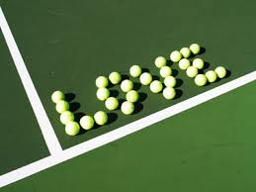
thank you ☺
Thank you for letting me expand the span of knowledge in your brain. Hopefully you now know a little more about tennis! You should be happy to brag to your friends that you are a tennis genius!

