Slide 1
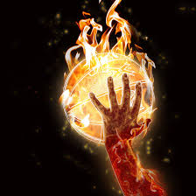
Basketball
By: Kayla Williams

Slide 2
Penalties
Double Dribbling
Traveling
Goaltending
Held Ball
Personal Foul
Technical Foul

Slide 3
Penalties Affect
If opponent is fouled while shooting a 3 pointer and misses, he\she gets 3 free throws
If opponent is fouled while shooting a 3 pointer and makes it, he/she gets 1 free throw

Slide 4
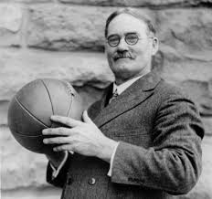
History
Dr. James Naismith invented Basketball.
In 1936 Basketball became an official sport in the Olympics.
The first time Basketball was played in Canada was in 1946.
Basketball hoops used to be peach baskets.
Basketball Hall Of Fame was made in 1959 in Spring Field.
In 1967 slam dunking was illegal.

Slide 5
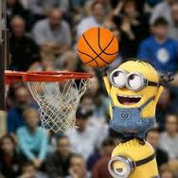
How To Score
To score you need to throw the basketball through the hoop
You can make 3 points 2 points 1 point
( free throw gets you 1 point)

Slide 6
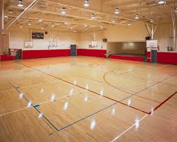
Field and Apparel
The hoop must be 10 feet above ground
The court must be 94 feet long and 50 feet wide
The court has has to have hardwood flooring
Basketball shirt (with your team logo on it)
Basketball shorts (with your team logo on it)
High Top shoes

Slide 7
Equipment
Basketball
Basketball hoop
A clock (that counts down)
A rectangle behind the hoop
A net around the goal

Slide 8
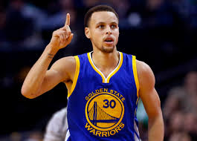
Famous Athlete Stephen Curry
His score is 280 3 pointer
He started Basketball in 2010
He played Final Four in 2015
He was MVP in Final Four
He played for Golden State Warriors

Slide 9
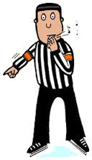
Rules
The ball can’t be thrown with two hands
No violence with opponent
You can’t strike the ball with your fist

Slide 10
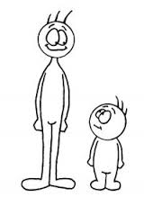
3 Interesting Facts
After Before
People thinks basketball can make you taller
There are 30 Basketball teams
2 Teams must have 5 players on the court

Slide 11
A Special Thanks To!!!
WWW.FunFacts.com
WWW.BreakthroughBasketball.com
WWW.101.com
WWW.NumberForce.com
WWW.SoftSchools.com
WWW.NBAHoops.com

