Slide 1
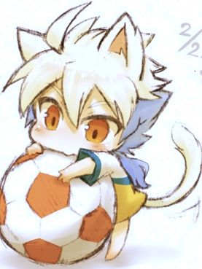
The soccer world
By Juan

Slide 2
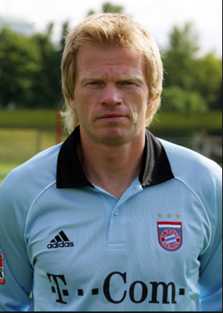
Fame from Oliver
Oliver Khan played for Argentina
Oliver Khan is a goal keeper
Oliver Khan's career started in 1987 and it ended in 2008.
Oliver Khan won the M.V.P award.
Oliver Khan winning record was 15 wins.
Oliver Khan competed in the world cup in 2003.

Slide 3
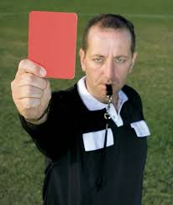
Rules
Must follow these
You must wear protective gear such as cleats and shin guards.
A soccer field must be a rectangle.
About 11 soccer players on each team.
Players must hit with their head, foot, and belly.
Must have home and away jersey
The length of a field must be a minimum of 100ft and the width of 60 – 75 ft and goal must be 20 yards

Slide 4
Types of players
Mid fielders have the job to unite the defense and offense
The defenders are the last line of defense for the goalkeeper
One in twenty injuries are caused by celebrating
Goalkeepers must act fast to keep the ball away
The ref is called a official
The players called the forwards have a goal to score goals

Slide 5
History
Mexico won the world cup in 2015
The original ball was in Pakistan 2014
The first live soccer broadcast was in 1937
1815 was when soccer was first played
The world cup is held every four years

Slide 6
LOTS of fouls
A deliberate ball grab is illegal
A punishment for a foul is a free kick
Tackling is a foul
Kicking an opponent is a foul
Spitting at an opponent is a foul
Striking at opponent is a foul
Ten types of fouls are resolved in a free kick sometimes yellow and red cards

Slide 7
continued
Charging at an opponent is a foul
Jumping at an opponent is a foul
Tripping opponent is a foul

Slide 8
Scoring
Kicking the ball into the goal will grant you a point.
You can earn a goal by a free kick
If a teammate kick the ball into your goal it will count for the other team

Slide 9
Thank you
Credit to
world book online .com/
Fact monster .com
Fact slides .com/s-soccer
Live strong .com/article/
Mrs. Anderson.
and other things
SOCCER IS AWESOME

