Slide 1
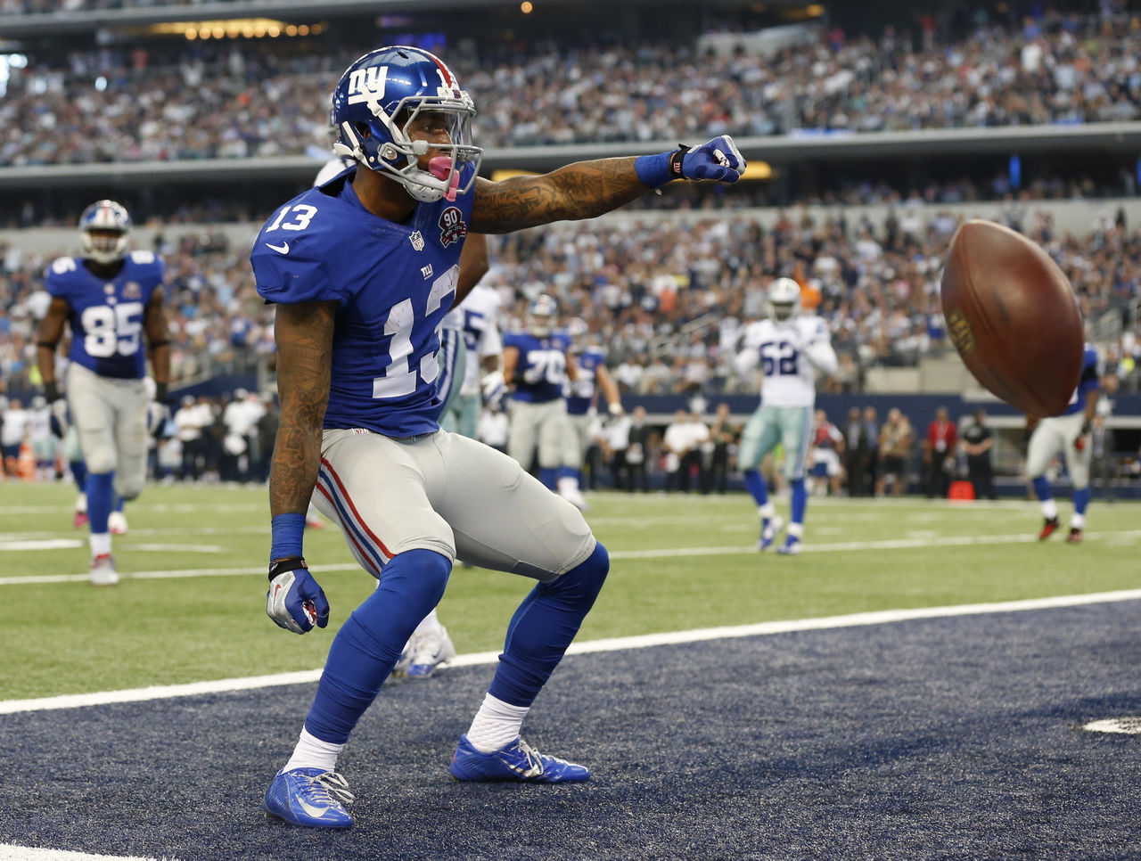
Football
Today I’m going to talk to you about football

Slide 2
How to score
An extra point is worth 1 point.
A touch down is worth 6 points.
If you get a safety it is 2 points.
You get 3 points for a field goal.
It used to not be 3 points.
The objective is to get the ball to the other side.
To score points you can either run, pass, or kick the ball.
You get an extra point from the 20 yard line.
A 2 point conversion is worth 2 points.
If you tie you go into over time

Slide 3
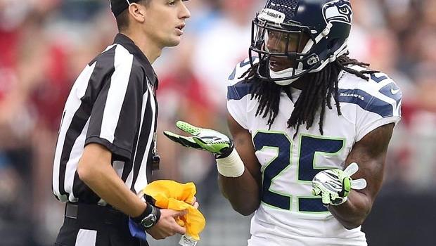
Rules & penalties
YOU CAN NOT CHEAT!!! ☹☹☹
You can’t argue with the ref.
You can not fight with the other team.
There can only be 11 people on the from each team.
Offense has the ball and defense defends the ball.
You are penalized by getting set back yards.
If you pass the line it is a penalty.
The height of the goal post is 35 feet.
The width of a field is 53 ½ yards.
Overtime lasts until a team scores
In Canada 12 people can be on the field

Slide 4
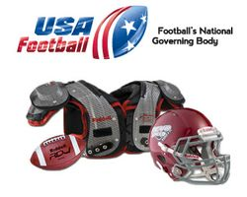
Wear and equipment
You wear shoulder pads, knee pads, a helmet, and a jersey over the shoulder pads.
Football is played with an oval ball.
You also need socks, cleats, gloves, and dri fit clothes

Slide 5
Famous athletes
Lawrence Taylor is a linebacker “best linebacker”
He played from 1981 to 1993.
He played for 12 years.
He was born in 1959.
He won the record for “Defensive Player of the Year”
Eli and Peyton Manning are brothers that both hold records.
Norm Van Brocklin’s passing record is 554 yards
William Heffelfinger was the first NFL player.
Beattie Feathers was the first 1000 yard rusher.

Slide 6
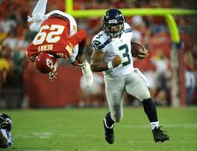
Famous athletes (continued)
William Heffelfinger didn’t play in any major competitions.
He played in 1867.
Lawrence Taylor played in Super bowl XXI and XXV.

Slide 7
history
NFL was formed in 1920.
The Chicago Bears have 735 wins in their history
The colts were the first team to have cheerleaders
A touchdown used to be 4 points.
In 1943 a helmet was not required.

Slide 8
☺ Fun facts ☺
A player scored 40 points in one game.
The color of the field post is bright yellow.
The “super bowl” for college is the grid iron.
NFL is the richest league.
It is also the most popular league.
The most fumble touchdowns in a game is 2.
NFL stands for national football league.
Most college players go to the NFL.
The wealthiest team is the Dallas cowboys

Slide 9
Fun facts (continued)
there is 273 people in the hall of fame
Elementary through professionals play football
Most rushing touchdowns in a game is 6
After a couple of years after retiring players go bankrupt
Kickoff, return kicks, and block and return punts are special teams
60% of the football games is spent at the line of scrimmage
There is usually 66,957 spectators at a game
The hall of fame is in Canton, Ohio

Slide 10
Fun facts (continued) … again
On the packers helmets the G stands for Greatness
The NFL has 32 teams
Injured people get 6 more seconds of camera time than celebrations
There is about 52 players on a team
A football field is 100 yards long
80% of SuperBowl tickets go to sponsors
The highest punt is 5,140 meters high
Soccer is also called football
About 1 million people fill football stadiums

Slide 11
Credits
www.coolfactsforkids.com/football-facts-for-kids/
https://kidskonnect.com/sports/football/
www.factmonster.com/ipka/A0882904.html
www.funtrivia.com/en/ForChildren/American-Football-for-Kids-18001.html
Worldbookonline.com/student/article?id=ar203760&st=football#tab=homepage

