Slide 1
GSP News
The topic today: rhythmic gymnastics

Slide 2
Rules and Penalties

Slide 3
Rules and penalties
No transparent leotards
Participants must be sixteen years old by the end of the year to participate.
Group time max:150 seconds Single time max:90 seconds
You are not allowed to put stuff in your hair
You can only use five types of equipment
Ribbons must be at least 6 meters long
Rope handles are not allowed
Routines should last between 75-90 seconds
You may not talk to another gymnast during an exercise

Slide 4
Rules and Penalties
If you can’t control the apparatus you get a penalty
Dropping the apparatus gets you a penalty
If the apparatus rolls of the floor more penalties occur
Deductions are taken for technical faults
Gymnasts are penalized for a second over or under the set time

Slide 5
History

Slide 6
History
The creators were Jean-Georges Noverre, Frank- Desalate, Emily-Jaques Dalecraze, and Isidor Duncan
Rhythmic gymnastics was an olympic sport in 1998
Used to be an independent sport

Slide 7
athletes

Slide 8
Anna Bessanova
1969 to 2005
2 Olympic medals 24 world championship medals 10 world cup medals
Represents Russia

Slide 9
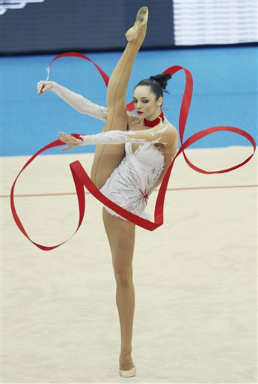
Anna Bessanova
Using a very creative ribbon technique

Slide 10
Irina Tchachina
1991 to now
1 olympic medal 9 world champion medals world cup medals
Represents Russia

Slide 11
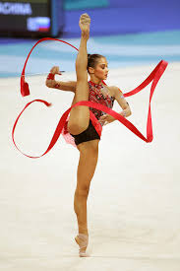
Irina Tchachina

Slide 12
Scoring

Slide 13
Scoring
Each panel of judges will judge a different part
Judges need to wear skirts and a navy blue sports coat
Judges will meet after scoring
The highest score 20.0
You are judged on difficulty, artistry, and execution
There three panels of judges

Slide 14
Helpful hints

Slide 15
Helpful hints
You can do group routines
You can do almost anything
Has six different competitive levels
Expected to use the entire floor
You need to use a ball, a rope, a hoop, a ribbon and clubs
You need balance, flexibility, coordination, and strength
You play with equipment instead of on equipment

Slide 16
Fun facts

Slide 17
Fun facts
Gymnasts do jumps, tosses, and leaps
Combines ballet and creative movement each gymnast spends an entire year preparing for two or three competitions
Everything is one on the floor
Rhythmic gymnastics is mostly a female sport
Gymnasts perform to music

Slide 18
A SPECIAL THANKYOU TO:
WWW.TopTenRhythmicGymnastsofAllTime.com
WWW.FIGGymnastics.com
WWW.FactMonster.com
WWW.RGAlberta.com
WWW.RhythmicGymnasticsRulesandJudging.com
WWW.SCN.com
WWW.OlympicGymnastics:TheBasicofRhythmicGymnastics.com

