Slide 1
Baseball
A national sport
A presentation
By Colin Cardinal

Slide 2
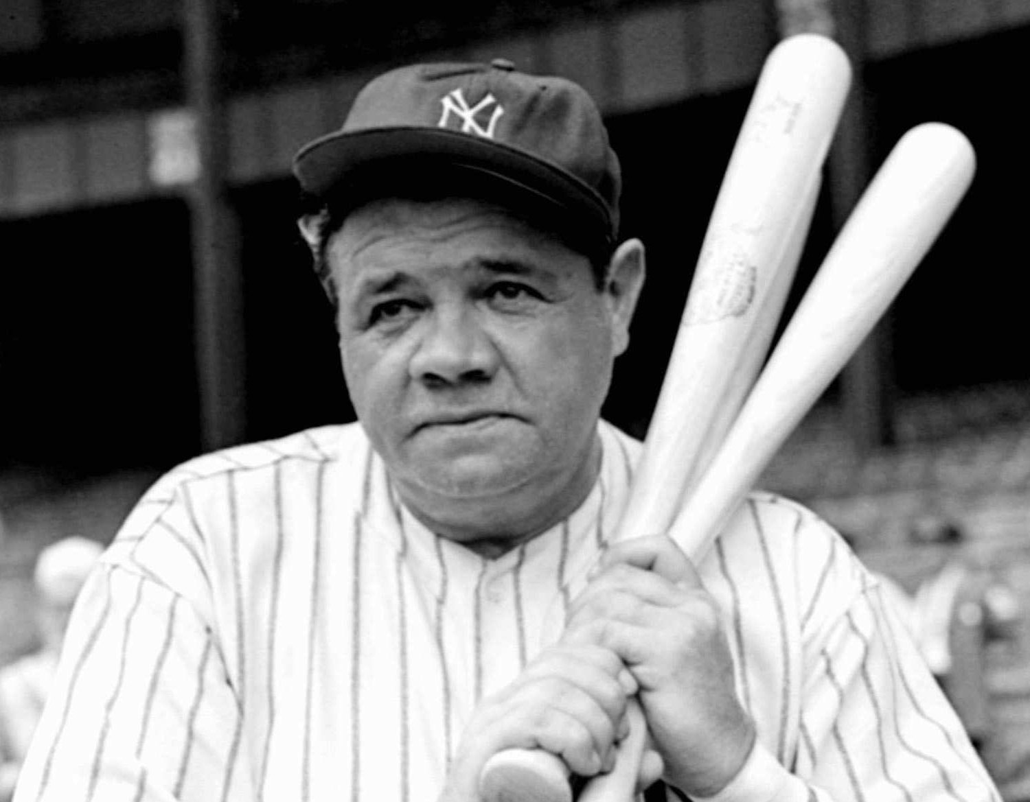
Babe Ruth
Babe Ruth is well known for being a great famous baseball player and I will talk about some facts about him

Slide 3
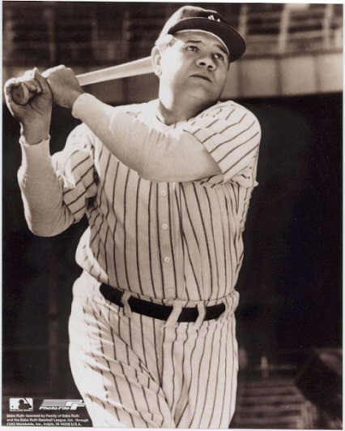
Babe Ruth was an outfielder and a pitcher. He played 1914 to 1945. He also played in the world series
Notes:
Mom I luv u

Slide 4
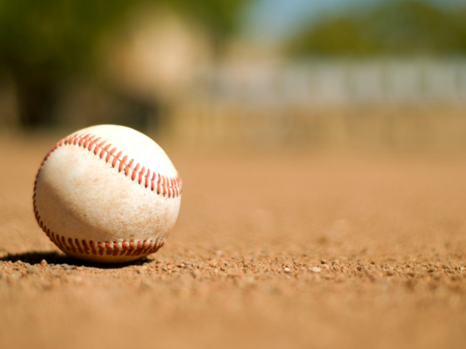
History
>>>>>>>>>>>>>>>>>>>
Baseball first started in 1845
All early baseball players were amateurs
Interest in baseball increased after 1900
Many radio stations started broadcasting baseball in the 1950s
Bob Gibson had the most strikeouts in the world series with 17 in 1968
A new generation of baseball stars emerged in the early 2000s
In 2006 the first world baseball classic was held

Slide 5
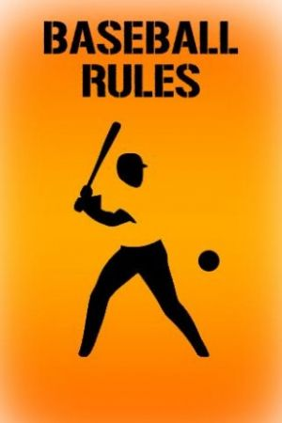
Rules
>>>>>>>>>>>>>>>
At first the pitcher stood 45 feet from home plate
The batter strikes out by making 3 strikes while at bat
Batters can reach the base without hitting the ball-walking the batter
Good base runners can steal bases and take the extra base on batted balls
9 players a team
You don’t have a time limit in baseball

Slide 6
A batter makes a foul by hitting a foul ball when there are fewer than two strikes against the batter
Bases in college and high school baseball fields are 90 feet apart
Originally a batter was out if a fielder caught the ball either on the fly or the first bounce.
If there is an odd number of players 1 player can play on both teams
Baseball players wear a jersey, hat, baseball socks, cleats, mitt, and batting gloves
There is no limit you can run in baseball
You can not bring food on the field
The field is a square with a base at each corner
The size of the outfield varies from field to field
The equipment in baseball is a baseball, a bat, gloves, and a helmet
The outfield is between the infield and the walls or fences
You score by hitting a ball and running to bases

Slide 7
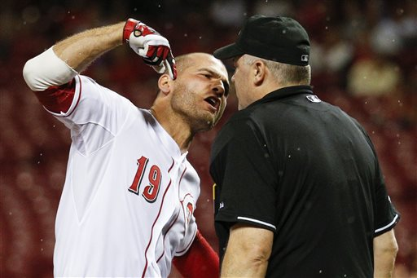
Penalties
You get disqualified by bad sports man ship
Hitting the batter with a pitched ball is a penalty… the batter automatically walks.

Slide 8
Fun facts
First second and third are filled with soft materials
Sometimes base runners run with the pitch
Most major leagues have 4 umpires
Most bats are made of wood
Baseball is a sport so popular in the US that it is often called the national pastime
When there are two outs , runners usually try to advance as soon as the fly ball is hit
Fly outs that hit short distances in the air are called pops
There are organized teams from 6 year olds to adults
Early major league baseball is sometimes called the dead ball era
Bunting and base stealing were more common in the early days
Early baseball batters only strike by swinging and missing
Early major league plays 162 games each season

Slide 9
There are 14 players that hit 4 homeruns in one game
At first the cities represented by major league teams changed often
The yankee’s have become baseballs strongest team
Baseball is popular outside the united states

Slide 10
I hope you enjoyed my presentation

