Slide 1
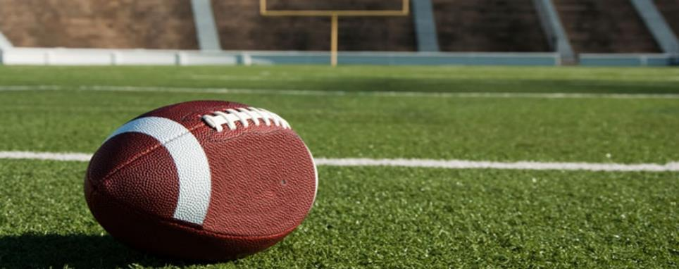
football
By Aidan Shellito

Slide 2
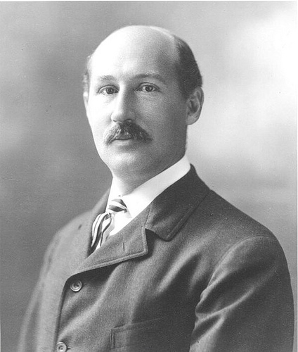
History
NFL was made in 1920. Walter camp was the creator of football. Football was made in 1864

Slide 3
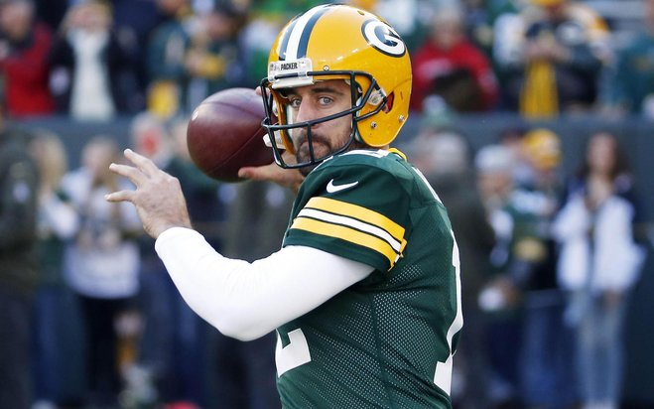
Aaron Rogers
Aaron Rogers is a football star and was born in California 1983. Aaron Rogers has played football since 1992 and his major game was super bowl in 1995. He is also good at Baseball. In Football he plays quarterback.

Slide 4
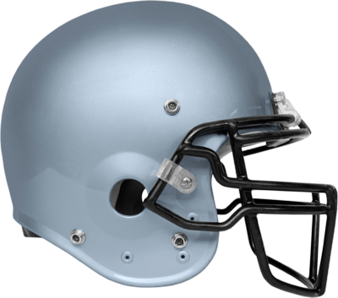
Equipment
In football you need to have special equipment here are some pieces of equipment you wear. A jersey, a rib pad, a helmet, a face mask, a chin guard, and a shoulder pad.
Here are some other things you don’t wear you use a tee, and a football.

Slide 5
Penalty/rules
The football has to be about about 27 cm long
The football field has to be 100 yards long
You can not punch people in the face
Halftime has to be 12-20 minutes long
The field has to be 53 yard wide
>>>>>>>>>>>>>>>>>>>>>>>>>>>>>>
One penalty is when you get kicked out of the game

Slide 6
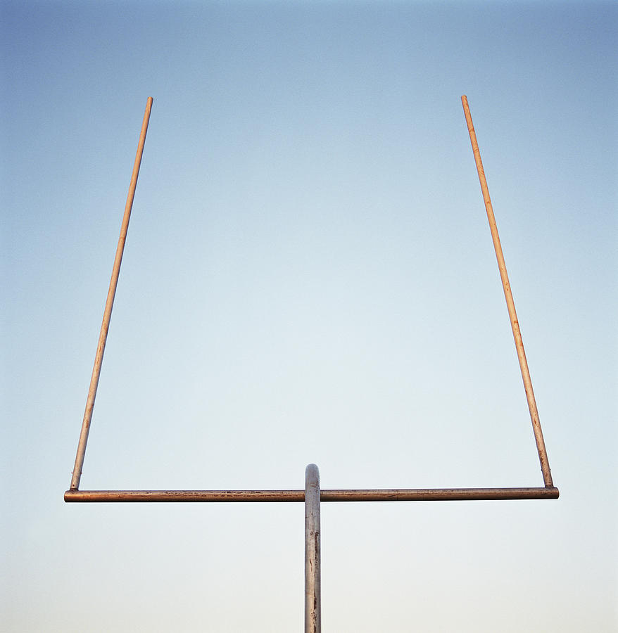
Scoring
In football there has to be some way to win right? Here are some ways to score. If you get a touch down you will get 6 points. If you can kick the ball through the posts after you score a touchdown you will get 1 point. If you run through the end zone you will get 2 points. If you get a field goal you will earn 3 points.

Slide 7
Interesting facts
There is touch football
Most pro football players are in college football first
You can quit the football league
The field has to be a rectangle
Football is related to soccer
There are 11 players
Back then people used to die in football
There are 4 quarters in football

Slide 8
More interesting facts
Super bowl is famous
You do not need to be that smart to play football
1 professional football game is 1 hour
It is easer to work together in football
The hall of fame is real, there is Elementary football
Another name for football is Gridiron
Football got famous in the 50’s
The Canadian Football League is called CFL
Football players can get up to $15,000,000 a year

Slide 9
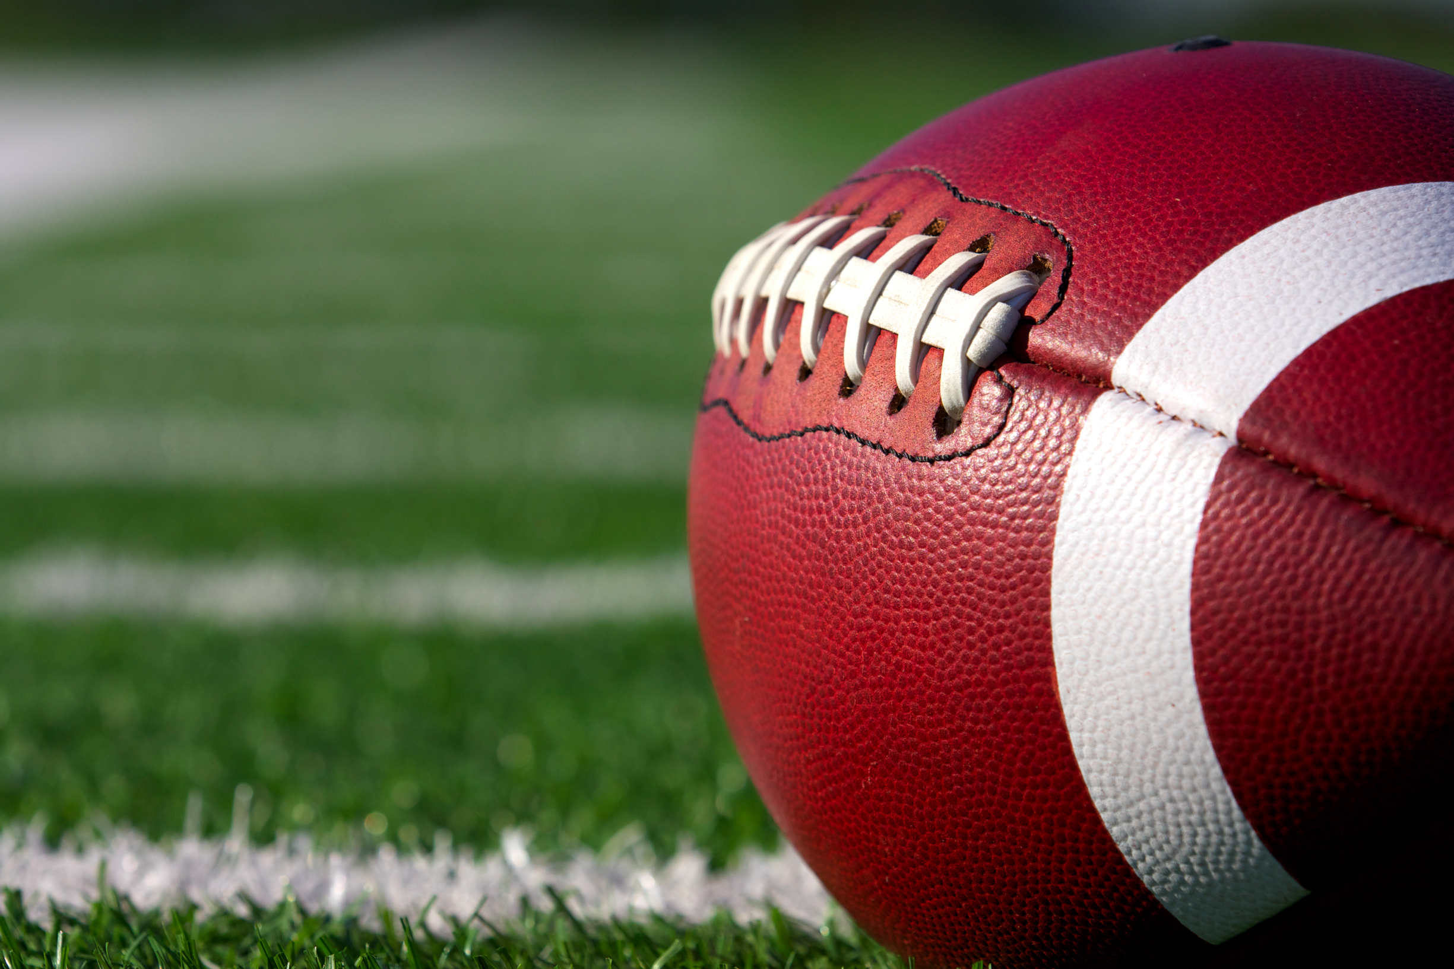
Even more interesting facts
There is flag football
A big guy is used to block the ball
The End

