Slide 1
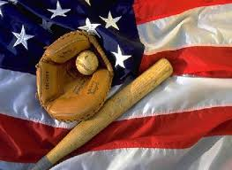
Baseball America’s Top Sport
By Aidan Hull

Slide 2
History
*Alexander Catwright invented baseball.
*The first game ever announced on the radio was the Chicago Cubs verses the White Sox.
*William Cummings invented the “Curve Ball” and mastered it before anyone else.
*The baseball Hall of Fame was created in 1935 to celebrate baseball’s 100th anniversary.
*The first world series was played in 1903.

Slide 3
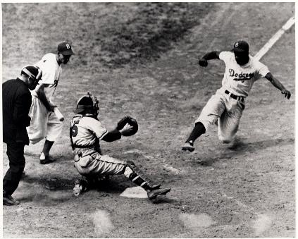
More History
*Baseball first became official in 1871.
*Baseball was first introduced in Japan.

Slide 4
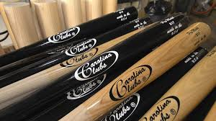
Equipment
*In T-Ball, they use a stand for hitting off of called a Tee.
*The stick for hitting is called a “Bat.”
*When you’re batting (optional) you wear gloves.
*The ball is called a baseball.
*To catch the ball you use a giant glove.
*The catcher has to wear a mask, a chest plate, and shin guards.
The shoes are called cleats.

Slide 5
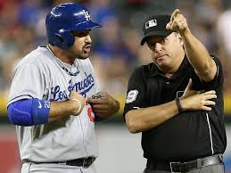
“The Only Penalty
*You can be called out for arguing with the umpire, or even be fined money in minor or major leagues.

Slide 6
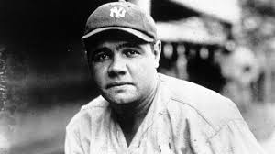
Babe Ruth
*Babe Ruth was one of the most famous players ever.
*When he was a kid, he loved being a catcher.
*They called him “The Big Bambino.”
*In his entire career, he hit 714 homeruns.
*He was born on February 6, 1895.
* He was first on the all time slugger list.

Slide 7
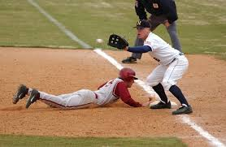
Rules
*To score, hit the ball and run around the bases.
*If someone tags you with the ball on defense, you’re out.
*If you’re hit with the ball while batting, you get walked.
*If you get four balls (bad throws), you get walked while batting.
*If you get three strikes while batting, you are out.
*If you hit the ball, and someone catches it, you’re out.

Slide 8
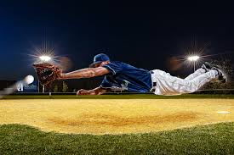
More Rules
*If the pitcher throws a bad ball, and you’re on base, you can run to the next before they tag you out.
*If you hit a ball over the fence, it’s an automatic run for you and anyone else on base.
*As the pitcher, if you throw to many bad throws, they’ll eventually change pitchers.
*If someone tags first base with the ball, before the batter
gets there, he/she is out.

Slide 9
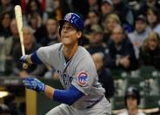
Player Facts
*Eddie Gaedal was the shortest baseball player in history and stood at 3 feet and 7 inches.
*Jimmy Pierall celebrated his 100th home run by running the bases backwards.
*Bobby Richardson won the world series for a losing team.
*Warren Spahn had as many career wins as hits.
*Lou Gehrig 23 grand slams in his entire career.
*Jack McCarthy threw out 3 batters in the same inning.

Slide 10
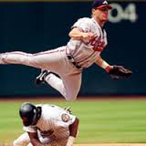
Fun Facts
*The first baseball field was built in Pittsburg.
*The Chicago Cubs don’t have a mascot.
*The Chicago Cubs were originally called “The Whales.”
Baseball is called “The national sport of the U.S.A.”
*The Cubs didn’t play at Wrigley field till 1916.
*There is a 300,000 to 1 chance that a fan will be hit by the ball.

Slide 11
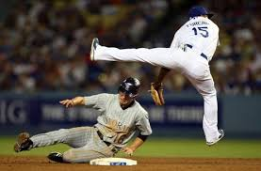
Fun Facts Continued
*The world’s largest baseball cap is 120 feet long, and 68,000 pounds.
*No one had an RBI in the 1968 All Star Game.

Slide 12
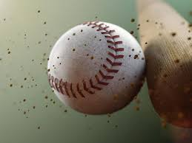
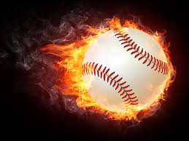
Acknowledgements
Thank you to the following websites
The Popcorn Factory.com
Fact Monster.com
Bleacher Report.com
Equipment for baseball.com
BabeRuth.com
Baseball Almanac
Ask.com

