Slide 1
Gymnastics
By Abby B.

Slide 2
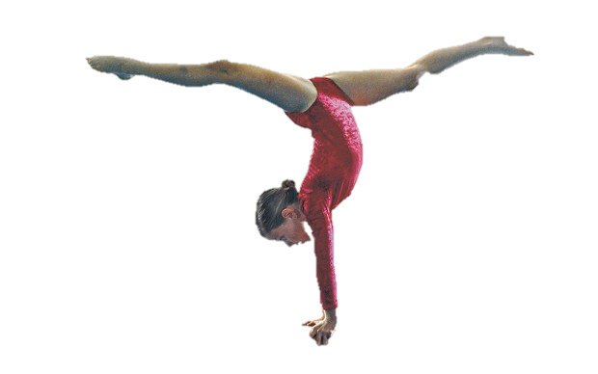
History
Friedrich Ludwig Jahn was the creator of Gymnastics, he was born Aug. 11, 1778 and passed away Oct. 15, 1852.
Although Friedrich created gymnastics, it originally started in Ancient Greece and it has been around for around 2,000 years!
It became a sport in 1896
Women weren’t allowed to participate until 1928

Slide 3
Scoring
Gymnasts are scored by how difficult the move is.
They are scored from 1-10
Judges deduct points from 10

Slide 4
Famous Athlete
Gabby Douglas
Full name: Gabrielle Christina Victoria Douglas
Born: December 1995
Nickname: Flying Squirrel
Grace, Gold, and Glory is one book about Gabby
She was in the Summer Olympics in 2012 (represented United States)
Awards: BET Young Stars Award, BET Award for Sports Women of The Year, Teen Choice Awards for Choice Female Athlete, and Glamour Award for the Unstoppables.

Slide 5
Famous Althlete Continued
Gabby won 2 gold medals
She accomplished a perfect cartwheel at 3 and a one hand handstand at 4.
Quote by Gabby:

Slide 6
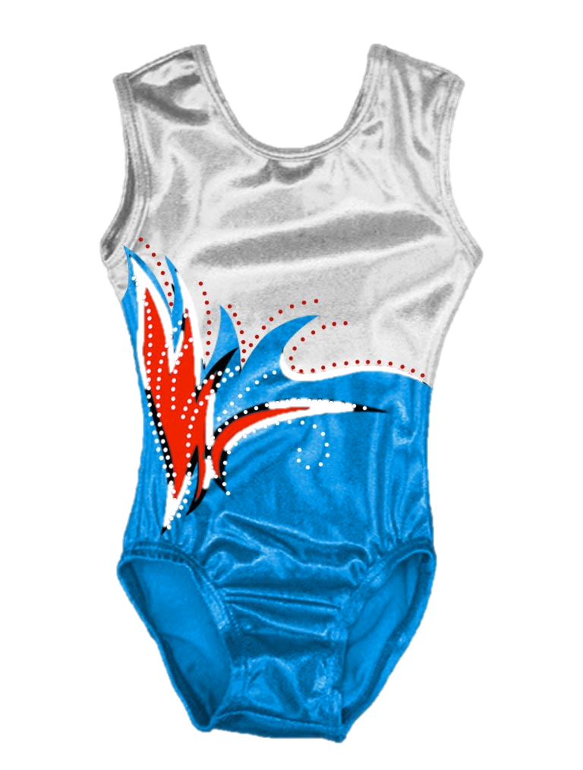
Equipment and Events
Uniform: Leotard and Shorts Leotard: A Skintight Body Suit for Gymnasts
Equipment: Mats, Vaults, Balance Beam, Uneven Bars, High Bars, Trampoline, chalk.
Chalk helps dry sweaty hands and helps with your grip
Men Events: Floor, Pammel Horse, Still Rings, Vault, parallel Bars, and High Bars.
Women Events: Vault, Uneven Bars, Balance Beam, and Floor Exercise

Slide 7
Rules
Requires Strength, flexibility, agility, and balance
Floor: Must Combine Tumbling and Dance
Vault: Must End in a Round Off or Cartwheel Hand Spring
For Gymnastics

Slide 8
Penalties
Uneven Bars: Extra Swing, Bent Legs/ Arms or Failure to Keep a Straight Body
Always Land With a Landing/Dismount
Floor Routine Must be 90 Seconds
Vault: Incorrect Arm Swing or Double Bounce on Board

Slide 9
Fun Facts
Gymnastics is VERY Dangerous!
Common Injuries: Bruises, Back Injures, Sprained Ankle, and Fractures Bones!
The Balance Beam Used to Be Just Wood and Didn’t Have Rubber/ Leather Until 1973!
Gymnastics Was in The 1st Olympics!

Slide 10
Credits
Http://kidskonnect.com
www.scholastic.com
http://Usagym.org
www.turtlediaries.com
www.Gymnastics.isport.com
http://wikipedia.org
http://gymreporter.com

